Slide 1
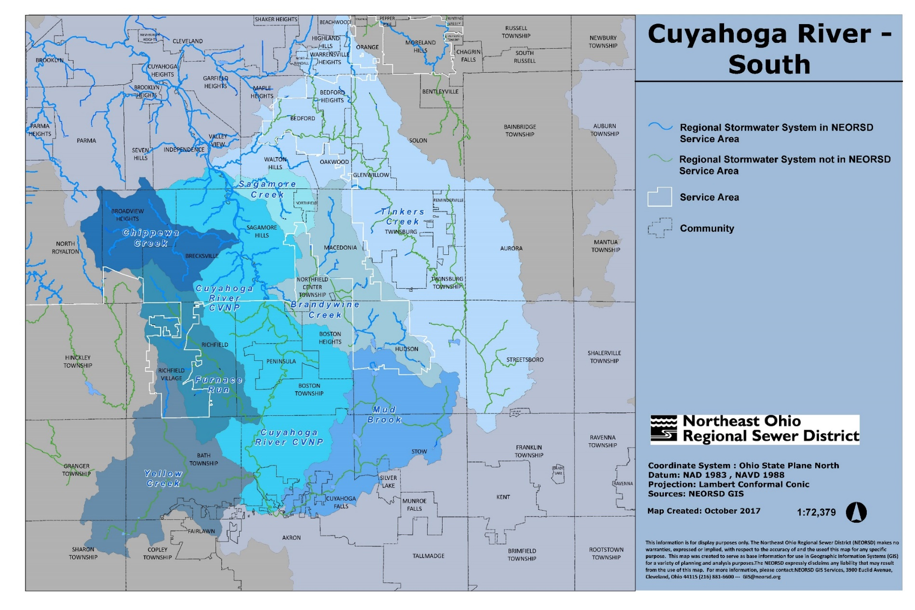
Stormwater Master Plan

Slide 2
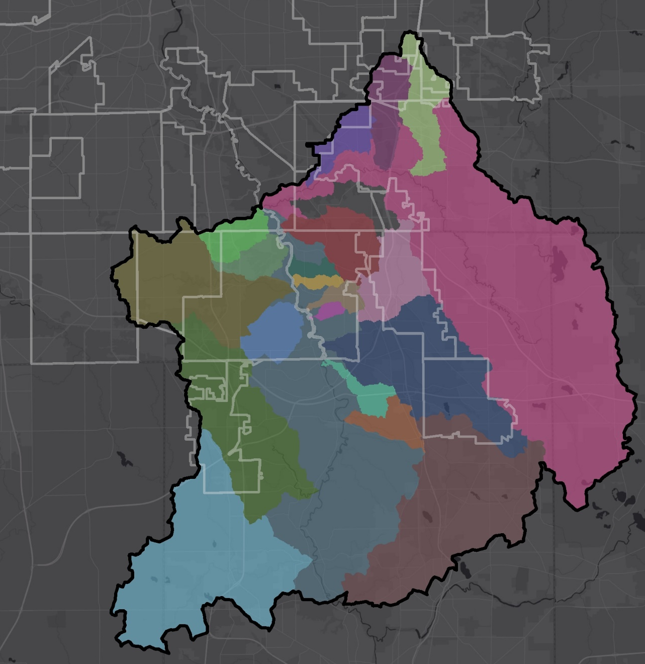
Cuyahoga River South SWMP
Total Study Area
184,000 acres
9 Subwatersheds in the SWSA
24 WAC Member Communities
Budget: $5.20 Million
Completion: April 2019
Notes:
Billed thru January - $4.69M; Earned Value $4.70M
January Invoice - $26,142
Estimated Balance –about $187,559.14
This does not include the PSAR7 or PSAR8.

Slide 3
Stormwater Master Planning
(status through 2/25/2019)
Completion Date: April 2019
Completion Date: November 2019
Completion Date: April 2020
Completion Date: May 2021

Slide 4
Cuyahoga River South SWMP
Subwatershed | Baseline Solutions |  | System Enhancements |  | DRAFT Total Estimated Construction Costs*
 | Number of RSS Assets | DRAFT Estimated Construction Costs* | Number of Project Areas | DRAFT Estimated Construction Costs*
Brandywine Creek | 20 | $2,392,000 | 17 | $56,260,000 | $58,652,000
Chippewa Creek | 21 | $2,542,000 | 7 | $55,373,000 | $57,915,000
Small Cuyahoga River East Tributaries | 3 | $102,000 | 3 | $3,583,000 | $3,685,000
Small Cuyahoga River West Tributaries | 8 | $622,000 | 5 | $7,680,000 | $8,302,000
Furnace Run | 3 | $597,000 | 4 | $1,448,000 | $2,045,000
Mud Brook | 0 | $0 | 0 | $0 | $0
Sagamore Creek | 8 | $40,000 | 3 | $7,743,000 | $7,783,000
Tinker’s Creek | 19 | $1,178,000 | 13 | $46,431,000 | $47,609,000
North Fork of Yellow Creek | 0 | $0 | 0 | $0 | $0
Cuyahoga River Mainstem | 5 | $25,000 | 4 | $17,762,000 | $17,787,000
Total | 87 | $7,498,000 | 56 | $195,280,000 | $203,778,000
 | * Planning level costs. Includes, property acquisition and easement, design and construction costs.
Notes:
The term Construction Cost is used instead of project cost, because that is the how the costs are referenced in the report.

Slide 5
Next Steps after Master Planning
Baseline Recommendations
  Policy implementation
  Small projects – bank/channel protection, monitor, structural repairs
  Recommendations do not identify owner or responsibility: Could be District, community, public agency, or private owner
Notes:
Baseline recommendations are common to all projects and alternatives.

Slide 6
Next Steps after Master Planning
Nomination to SW Construction Plan
  Design and Construction
  6 Project Areas in 2018, remaining in 2019
Property Acquisition
Advanced Stormwater Planning
  Small group of complex / costly projects
  Up to 30% design
Notes:
Chippewa Creek SWMP Project Area 9 - Echo Lane Flooding Project in Broadview Heights (Broadview Heights)
Indian Creek SWMP Project Area 1 - Valley View/E Aurora (Macedonia)
Brandywine Creek SWMP Project Area 4 - E Highland Restoration (Macedonia)
Indian Creek SWMP Project Area 2 - Bedford/Ledge Flooding (Macedonia)
Brandywine Creek SWMP Project Area 1 - Stream Restoration (Sagamore Hills Twp)
Chippewa Creek SWMP Project Area 6 - Flooding near Cherry Hill Lane (Broadview Heights)

Slide 7
Next Steps after Master Planning
Community Reports - Include:
  Recommendations within each community
    Problem areas
    Baseline projects
    Design/Construction Projects
  Cost estimates
  WTLs will deliver reports during a scheduled
  community meeting
Notes:
The discussion will focus on the technical findings of the reports, details on projects responsibility will need further discussion for those areas where there is a shared responsibility.

Slide 8
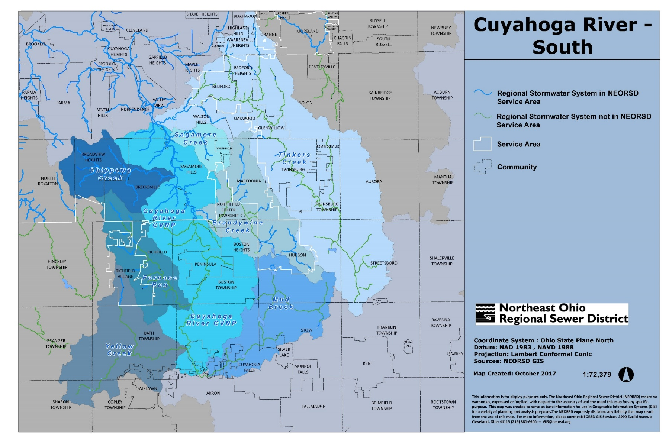
Questions

