Slide 1
Opening doors to minority-owned, woman-owned, and small business enterprises in Northeast Ohio
Notes:
Thank you Tiffany.
Contract Project Coordinator –
role is to audit contracts that include firms certified with the District’s BOP
many District contracts have BOP spending goals, which encourage prime contractors to subcontract part of the work.
BOP certified firms can also serve as primes on jobs and can get work through requisitions.
My goals for today’s presentation:
Provide overview of our program’s accomplishments
Provide overview of the range of opportunities for your small business
Provide you the tools you need to be able to find these opportunities
Get you excited about becoming certified with our Business Opportunity Program

Slide 2
Engineering & Construction
(CIP)
Watershed
Programs
(Stormwater)
Operations
Materials
&
Services
RANGE OF OPPORTUNITIES FOR DOING BUSINESS WITH THE DISTRICT
Notes:
Overview of 4 areas of opportunity for work with District:
E&C – Capital Improvement Plan
Stormwater
Operations
Materials and Services, also referred to as Goods and Services

Slide 3
Engineering & Construction
(CIP)
Watershed
Programs
(Stormwater)
Operations
Materials
&
Services
RANGE OF OPPORTUNITIES FOR DOING BUSINESS WITH THE DISTRICT
Notes:
Will start with Engineering and Construction and the CIP
Capital Improvement Plan

Slide 4
Annual Cash Flow for Construction Projects 2013-2016
Notes:
Look back at our Program’s accomplishments:
Columns – annual total cash flow in CIP construction
Purple – BOP firms
Blue – non-BOP prime firms
HIGHLIGHTS
– each year achieved $30M to BOP
20% or more of total spend went to BOP certified firms
Our program target for CIP projects is 20% and we have met/exceeded that each of the past 4 years

Slide 5
Total Cash Flow for Construction Projects 2013-2016
Notes:
Pie chart summarizes previous graph
HIGHLIGHT – 21.9% total cash flow went to BOP firms
$135M went to MWSBE certified firms based in NE Ohio
We are putting $ back into our community and creating opportunity

Slide 6
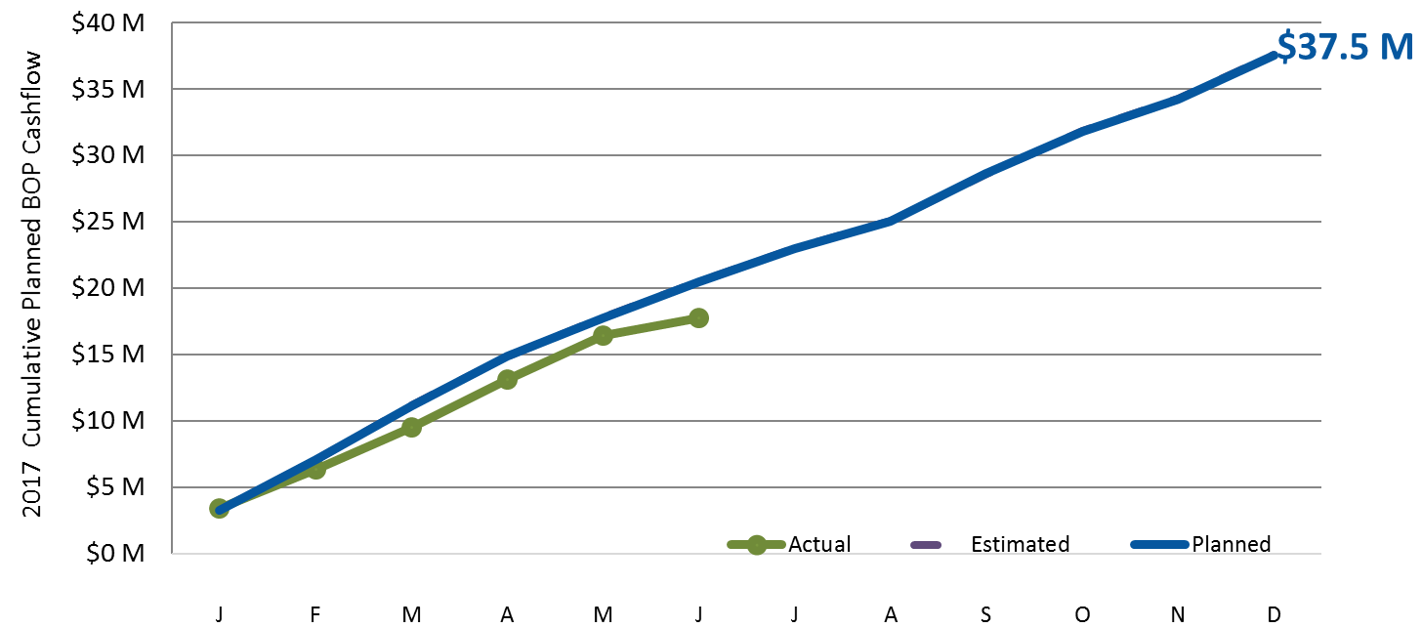
2017 business opportunity program cashflow
Planned $20.5 M
Actual $17.8 M
Notes:
I just showed you our historical data, or where we have been.
I’d like to switch gears now and discuss where we are going.
This chart shows the anticipated total BOP cashflow for construction projects in 2017.
As you can see, we are anticipating $37.5 million in BOP spending this year.

Slide 7
Capital Improvement Plan (CIP): 2017-2021 Projects
$ 1.38 billion*- anticipated construction project awards during this 5-year period.
Projects and contract award values by program area:
Combined Sewer Overflow Control Program (CSO) $1.17 billion (85%)
Wastewater Treatment Plants $126.3 million (9%)
Collection Systems $50.9 million (4%)
Districtwide Activities $28.4 million (2%)
* as of 7/31/17
Notes:
So, now you have seen what we have done. BUT WHAT IS COMING UP??
The District has developed a 5-year spending plan called the Capital Improvement Plan or CIP.
The current CIP covers the period 2017 – 2021.
As of 7/31/17, our anticipated construction project awards during this period total $1.38 billion.
These awards are broken down into several major program areas
This information is updated monthly during the year to reflect the updated status of these projects.
Now I would like to show you how you can find this information for yourself so you can stay up to date on upcoming opportunities.

Slide 8
Examples of CIP Construction Services
Landscaping (trees, shrubs, seeds, mowing) | Electrical (installation, supplies, equipment)
Fencing | Concrete structures
Asphalt pavement | Traffic control
Material hauling/trucking | Surveying
Photography | Systems integration
CCTV/inspection | Ready mix concrete
Saw cutting | Trailers
Aggregate supplies | Geotechnical instrumentation
Shaft excavation | Security
Masonry | Metal fabrication
Notes:
Slide shows some examples of the types of contracting work involved in our CIP projects.
This is NOT comprehensive – want to show the VARIETY of possibilities

Slide 9
neorsd.org
Notes:
Hopefully you are wondering how you can find out about upcoming projects.
Let me show you!
neorsd.org – District homepage
Click on Business

Slide 10
neorsd.org
Notes:
Doing Business with Us
Capital Improvement Plan

Slide 11
2017-2021 CIP Program Summary
Notes:
2017-2021 CIP Program Summary – lists all the anticipated projects during this period
Project name and location

Slide 12
2017-2021 CIP Program Summary
Notes:
Progression or timeline of the project –
RFP = Request for Proposals
(Board authorizes E&C to issue the request to design firms)

Slide 13
2017-2021 CIP Program Summary
Notes:
Design = Board awards the Design contract

Slide 14
2017-2021 CIP Program Summary
Notes:
Award of Construction = Board awards the Construction contract

Slide 15
2017-2021 CIP Program Summary
Notes:
Construction estimate – this is for the total job
NOTE - we establish BOP goals for these projects, so there are smaller subcontracting possibilities for our BOP certified firms

Slide 16
2017-2021 CIP Program Summary
Notes:
Show Project Summaries
Click this --- expands the project description with more information

Slide 17
2017-2021 CIP Program Summary
Notes:
Expanded project summary sample

Slide 18
Upcoming CIP Projects
Project | Award of Construction | Construction Estimate ($M)
Westerly Storage Tunnel | 1st Quarter 2018 | $160.0
The WST project includes the installation of a 21-foot diameter storage tunnel extending approximately 14,000 feet in length from its connection to the Westerly Tunnel Dewatering Pump Station (WTDPS) near the WWWTC.
Easterly Chemically Enhanced High Rate Treatment Facility | 1st Quarter 2018 | $125.0
The Easterly Chemically Enhanced High Rate Treatment (CEHRT) Facility is Consent Decree Control Measure 2. This facility must start design within 6 months of approval of the Pilot Testing Report. The Easterly CEHRT project includes preliminary design and then design of the new high rate treatment facility to treat CSO-001 based upon the findings documented in the Pilot Testing Report.
Dugway Regulators and Relief Sewers | 2nd Quarter 2018 | $3.5
This Dugway Regulators & Relief Sewers (DRRS) project will be designed and constructed in order to meet specific CSO control requirements of Control Measure #6 as identified in Appendix 1 of the Consent Decree. When complete, the project will provide CSO control for the Typical Year storm events and flood relief up to the 5-year, 6-hour storm within the Dugway Interceptor system. The project will provide relief/consolidation sewer pipe ranging from 12-inch to 30-inch with installation methods including open-cut and small diameter trenchless methods; regulator modifications, a new regulator structure, and a new drop structure.
London Road Relief Sewer | 2nd Quarter 2018 | $38.4
The London Road Relief Sewer (LRRS) project will provide surcharge relief for sewers tributary to the Ivanhoe-Holmes Branch Interceptor along Holmes Avenue and London Road, and intra-community relief sewers on Roseland Drive and Green Road. The project will also control combined sewer overflows to Green Creek and Nine Mile Creek. The project includes relief systems ranging from 18 to 84 inches in diameter with a total length of approximately 15,500 feet.
Notes:
Pulled out 4 sample projects to show you.
These will all be awarded in 2018.
Some are very large projects but just remember – we will have BOP goals on these projects and there will be subcontracting opportunities available.

Slide 19
Contacts for additional information about CIP projects
NAME | TITLE | EMAIL
Douglas A. Gabriel | Deputy Director of Engineering and Construction | GabrielD@neorsd.org
Robert Pintabona | Plants Design Program Manager | PintabonaR@neorsd.org
Doug Lopata | CSO/Collection System/Stormwater Design Program Manager | LopataD@neorsd.org
Rick Vincent | CSO Design Manager | VincentF@neorsd.org

Slide 20
Engineering & Construction
(CIP)
Watershed
Programs
(Stormwater)
Operations
Materials
&
Services
RANGE OF OPPORTUNITIES FOR DOING BUSINESS WITH THE DISTRICT

Slide 21
Stormwater Program Summary: 2017-2021 Projects
$ 36.3 million*- anticipated stormwater project awards during this 5-year period.
Projects and contract award program areas:
Cuyahoga North
Cuyahoga South
Chagrin River
Rocky River
Lake Erie District
Districtwide Activities
* as of 7/31/17
Notes:
Like we saw with Construction, our Stormwater program has a 5-year plan
$36.3 million anticipated

Slide 22
Examples of Stormwater Construction Services
Landscaping (bioengineering materials, trees, shrubs, seed, etc.) | Concrete work (pipe extensions, etc.)
Tree clearing and grubbing | Material hauling/trucking
Asphalt pavement | Traffic control
Fencing | Riprap supply
Photo/video inspection | Surveying/bathymetry
Notes:
Again, examples of services for these projects –
Landscaping
Tree clearing and grubbing

Slide 23
neorsd.org
Notes:
How to find these projects?
Homepage
Business
Doing Business with us
Stormwater Construction Program

Slide 24
Stormwater Construction Program

Slide 25
2017-2021 Stormwater Program Summary
Notes:
Similar chart outlining the anticipated projects.

Slide 26
Upcoming Stormwater Projects
Project | Award of Construction | Construction Estimate ($M)
Colombo Park Stream Restoration | 21-Dec-17 | $1.2
The project site is along both the left and right banks, approximately 300 ft in length. The project includes stabilization of the stream banks.
Spring Creek Culvert Rehabilitation | 1st Quarter 2018 | $0.7
Rehab approximately 490 feet of a culverted stream along Spring Creek from west of Bradley Road to the Cuyahoga River in the City of Cleveland. Project is located in an industrial area and requires cooperation with affected property owners that includes the City of Cleveland and CSX Railway. The project was initiated because of a collapsed section of the culvert.
Doan Brook Stream and Bank Stabilization | 2nd Quarter 2018 | $2.4
The project will stabilize and rehabilitate approximately 1,000-feet of stream channel and convert available contiguous land into hydraulically-connected and functioning floodplains. The proposed improvements will avert significant streambank erosion within the project area as well as provide stormwater quality improvements for a portion of the Doan Brook watershed. When completed, the project will provide streambank stabilization, protection of utilities and infrastructure, flooding relief, improved stream flow, enhanced streamside riparian areas, aesthetic improvements and improved public access to this section of Doan Brook.
Big Creek Stabilization | 2nd Quarter 2018 | $4.5
The project will provide streambank stabilization along Big Creek and protection of roadways, parking lot, railroad, drop structure and other infrastructure.
Notes:
List of 4 sample projects coming up

Slide 27
Contacts for additional information about Stormwater projects
NAME | TITLE | EMAIL
Frank P. Greenland | Director of Watershed Programs | GreenlandF@neorsd.org
David Ritter | Manager Of Watershed Technical Support | RitterD@neorsd.org
Janet Popielski | Stormwater Design & Construction Program Manager | PopielskiJ@neorsd.org

Slide 28
Engineering & Construction
(CIP)
Watershed
Programs
(Stormwater)
Operations
Materials
&
Services
RANGE OF OPPORTUNITIES FOR DOING BUSINESS WITH THE DISTRICT

Slide 29
neorsd.org
Notes:
Homepage
Business
Doing Business with us
Bids and Proposals

Slide 30
Active Bids and Proposals
Notes:
Here is a sample of the active bids and proposals section of website.
NOTE – This is sample to show what it looks like. This information is changing all the time so up to YOU to check it regularly to see what is coming up.
OPEN – this is the date the bid/proposal is DUE.
CLICK LINK to get specific details and information about requirements.
Sometimes there is a MANDATORY PRE-BID MEETING so you want to read the info and plan accordingly.

Slide 31
Operations Bid
Notes:
AGAIN, this is a SAMPLE of a recent operations bid.
There were no active bids to show you today but this gives you an idea of how to find the information and what is included….

Slide 32
Upcoming Operations Contracts
Contract | Contract Period | Bids/Quotes | Estimated Expenditures
Grounds Maintenance Services | April 1 thru March 31 | January annually | $185,000.00 in total. Each contract will be smaller.
Provide grass cutting, weed and debris maintenance, watering, and landscaping services for GJM, EMSC, Southerly, Westerly, Outlying facilities and any property acquisitions that need maintained. Vendors must provide their own equipment, tools and safety gear to provide services and must provide staff certified to apply commercial herbicides. Sites are grouped into geographic areas. Vendors can bid one or multiple groups. Normally multiple contracts are awarded. Vendors must visit sites before they can submit a bid.
Preventative Maintenance for Material Handling Equipment | Had been a 1-year contract. Moving to a 2-year contract. | June or July 2018 | $70,000.00 in total for two years.
Provide regular scheduled preventative maintenance and as needed repairs to various scissor lifts and forklifts at District facilities. Work must meet OSHA standards and any other regulatory requirements including obtaining needed permits. Bio-based materials to be used in providing services. Inspection reports must be provided.
Rubbish Removal | September 1 thru August 31 | July or August annually | $40,000.00 in total. Normally one contract awarded.
Provide regular pick up of trash and recycling containers at all five main District facilities. Services for pump stations provided on as a needed basis. Vendors must provide their own containers at each site.
Snow Plowing Services | November 1 thru April 30 | August or September annually | $67,000.00 in total. Each contract will be smaller.
Provide snow plowing and deicing services for GJM, EMSC, Pump Stations and all of the District’s Outlying Facilities. Vendors must provide the services any time there is 2” inches of accumulation before 6 or 7 am. Sites are grouped into geographic areas. Vendors can bid one or multiple groups. Normally multiple contracts are awarded. Vendors must visit the sites before they can submit a bid.

Slide 33
Contact for additional information about Operations contracts
NAME | TITLE | EMAIL
Delilah Capeles | Operations & Maintenance Procurement Administrator | CapelesD@neorsd.org

Slide 34
Engineering & Construction
(CIP)
Watershed
Programs
(Stormwater)
Operations
Materials
&
Services
RANGE OF OPPORTUNITIES FOR DOING BUSINESS WITH THE DISTRICT

Slide 35
Materials and Services
Purchasing Department
< $50,000 =
requisition to vendors for quotes
> $50,000 =
Board authorization, advertised for bids

Slide 36
neorsd.org

Slide 37
Register as a new vendor

Slide 38
Active Bids and Proposals
Notes:
Same page – active bids and proposals.
AGAIN – this is a SAMPLE of a SERVICES PROPOSAL…
Always changing, keep an eye on this!

Slide 39
Services Proposal
Notes:
SAMPLE SERVICES PROPOSAL – there is a link included so you can DOWNLOAD the specific requirements of the proposal.

Slide 40
Opening doors to minority-owned, woman-owned, and small business enterprises in Northeast Ohio
Notes:
I hope I have helped to show you the WIDE VARIETY of business opportunities available at NEORSD.
As I mentioned at the beginning of the presentation, I had 4 goals:
Provide overview of our program’s accomplishments
Provide overview of the range of opportunities for your small business
Provide you the tools you need to be able to find these opportunities
Get you excited about becoming certified with our Business Opportunity Program
I am now going to address #4 – We will start with a short video and then I will hand over the presentation to our Certification Officer, Diana Jones.

Slide 42
Business Opportunity Program
Certification Clinic

Slide 43
What is the Business Opportunity Program (BOP)
The purpose of certification
The criteria for applying to the BOP
The required documentation for the BOP
Question and Answers

Slide 44
Minority-Owned Enterprise (MBE)
Women-Owned Enterprise (WBE)
Small Business Enterprise (SBE)

Slide 45
Why is SBE/WBE/MBE Certification necessary?
Certification is voluntary.
Certification verifies ownership and business control.
Certification provides access to private procurement and networking events and second-tier business opportunities.

Slide 46
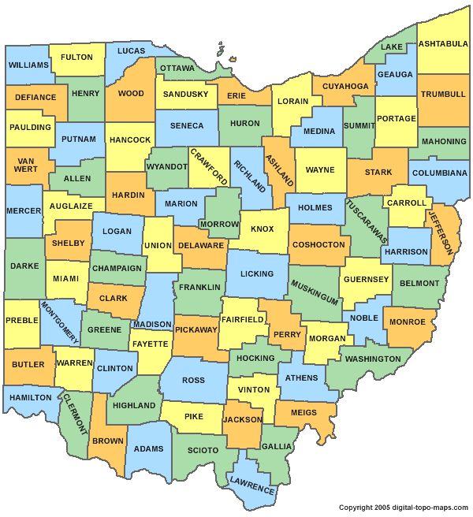
Certification Requirements
To be certified the Sewer District requires the business to:
Have a physical business address
Operate in: Ashtabula, Carroll, Cuyahoga, Geauga, Lake, Lorain, Mahoning, Medina, Portage, Stark, Summit, or Trumbull

Slide 47
NAICS Size Standards
Industry | District Size Standard
Accounting and Payroll | $4,250,000
Architecture and Engineering Services | $33,500,000
Construction | $33,500,000
Consulting | $14,000,000
Goods | $3,500,000
Special Trades | $14,000,000
Trucking | $25,500,000
Waste Management | $6,250,000
Remediation Services | $7,000,000

Slide 48
Are you certified with any of the following agencies?
- City of Cleveland
- Cuyahoga County
- Ohio Minority Supplier Development Council
(formerly NOMSDC)
- State of Ohio MBE/EDGE Program(s)
- Unified Certification Program
- Woman Business Enterprise National Council
- US SBA 8 (a) Program

Slide 49
Document Checklist
ALL FIRMS MUST PROVIDE THE FOLLOWING ITEMS:
Proof of MAJORITY OWNER or principal.
Relevant licenses, registrations, or permits.
Equipment list.
Copy of business insurance certificate(s).
Three copies of current contracts or invoices.
Certificate of Good Standing from the Secretary of State.

Slide 50
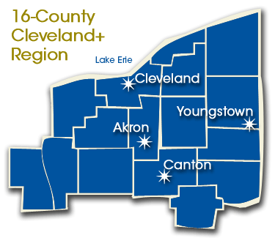
Community Benefits to Certification
By establishing a certification program the Sewer District will make more investments in the regional economy.
We will work with local companies, increasing business opportunities and prospects to qualified M/W/SBEs in our service area.

Slide 51
Office of Contract Compliance
Tiffany Jordan
Contract Compliance Manager
Jordant@neorsd.org
Diana Jones
Certification Officer
Jonesd@neorsd.org
Tracy Miller
Contract Project Coordinator
Millertracy@neorsd.org
Galen Adams
Prevailing Wage Officer
Adamsg@neorsd.org

